Slide 1
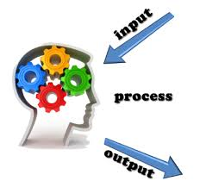
Input & Ouput
I/O occurs in streams, which are sequences of bytes.
Input operation.
Output operation.
Notes:
Title + Bullets + Image
No more than 4 points. Please use another similar slide incase you have more points.

Slide 2
Header files for I/O operation
iostream
iomanip
fstream
Notes:
Title + Bullets + Image
No more than 4 points. Please use another similar slide incase you have more points.

Slide 3
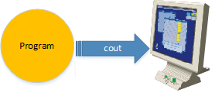
Standard Output Stream (cout)
cout
<< insertion or put to operator
endl
Notes:
cout is the instance of the ostream class.
Data needed to be displayed is inserted in cout using << insertion operator
The insertion operator << directs the content of the variable on its right to the object on its left.
endl is used to add a new-line at the end of the line.

Slide 4
#include <iostream>
using namespace std;
int main()
{
char str[] = ”HELLO";
char str1[] = ”WORLD";
cout << str << endl << str1;
return 0;
}
1
2
3
4
5
6
7
8
9
10
11
12
13
14
15
HELLO
WORLD
Output

Slide 5
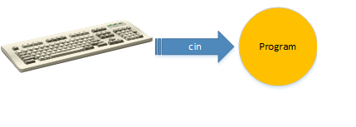
Standard Input Stream (cin)
cin
>> extraction or get from operator
Notes:
Usually the input device is the keyboard. cin is the instance of the class istream and is used to read input from the standard input device which is usually keyboard. The extraction operator(>>) is used along with the object cin for reading inputs. The extraction operator extracts the data from the object cin which is entered using the keboard.

Slide 6
#include <iostream>
using namespace std;
int main()
{
int value;
cin >> value;
cout << value;
return 0;
}
1
2
3
4
5
6
7
8
9
10
11
12
13
14
15
5
5
Output

Slide 7
Type Conversion
Converting one predefined type into another
Implicit Type Conversion
Explicit Type Conversion
Notes:
The process of converting one predefined type into another is called as type conversion. When constants and variables of different types are mixed in an expression, they are converted to the same type. When variables of one type are mixed with variables of another type, a type conversion will occur.

Slide 8
Implicit Type Conversion
Done by compiler on its own
Takes place in an expression when more than one data type is present
All the data types of variables are upgraded to data type of variable with largest data type
bool -> char -> short int -> int -> unsigned int -> long -> unsigned-> long long -> float -> double -> long double

Slide 9
#include <iostream>
using namespace std;
int main()
{
int x = 20;
char y = 'c';
x = x + y; // y implicitly converted into int
float z = x + 1.5; // x implicitly converted into float
cout << "x = " << x << endl
<< "y = " << y << endl
<< "z = " << z << endl;
return 0;
}
1
2
3
4
5
6
7
8
9
10
11
12
13
14
15
x = 119
y = c
z = 120.5
Output

Slide 10
Explicit Type Conversion
User can typecast the result to make it of a particular data type.
Converting by assignment
Conversion using cast operator

Slide 11

#include <iostream>
using namespace std;
int main()
{
double x = 7.3;
int sum = (int)x + 3; // explicit conversion from double to int
cout << "Sum = " << sum;
return 0;
}
CONVERTING BY ASSIGNMENT
1
2
3
4
5
6
7
8
9
10
11
12
13
14
15
Output
Sum = 10
Notes:
Output

Slide 12
#include <iostream>
using namespace std;
int main()
{
float f = 9.5;
int b = static_cast<int>(f); // using cast operator
cout << b;
}
CONVERSION USING CAST OPERATOR
1
2
3
4
5
6
7
8
9
10
11
12
13
14
15
Output
9
Notes:
Output

Slide 13
Operators
An operator is a symbol that tells the compiler to perform certain mathematical or logical manipulation.
Operators are used in program to manipulate data and variables.
a + b a and b -> operands
+ -> operator
C++ Operators are classified into several categories.

Slide 14
Types of Operators
Arithmetic Operators
Relational Operators
Assignment Operators
Logical Operators
Increment and Decrement Operators
Special Operators

Slide 15
Arithmetic Operators
An arithmetic operator performs mathematical operations such as addition, subtraction and multiplication on numerical values (constants and variables)
Operators | Example a = 10, b = 5
+ | a + b = 15
- | a – b = 5
* | a * b = 50
/ | a / b = 2
% | a % b = 0

Slide 16
If you have more than one arithmetic operator in an expression, which operator will execute first?
B O D M A S
/
*
+
-
of
Brackets ()
Notes:
Explain that BODMAS is rule which is used in every language.

Slide 17
What is the difference between % and / operator?
/ -> Quotient
% -> Remainder
Notes:
Ask the students first then move the slide.

Slide 18
Relational Operators
A relational operator checks the relationship between two operands. If the relation is true, it returns 1; if the relation is false, it returns value 0.
Relational operators are used in decision making and loops.
It is used to form a condition.

Slide 19
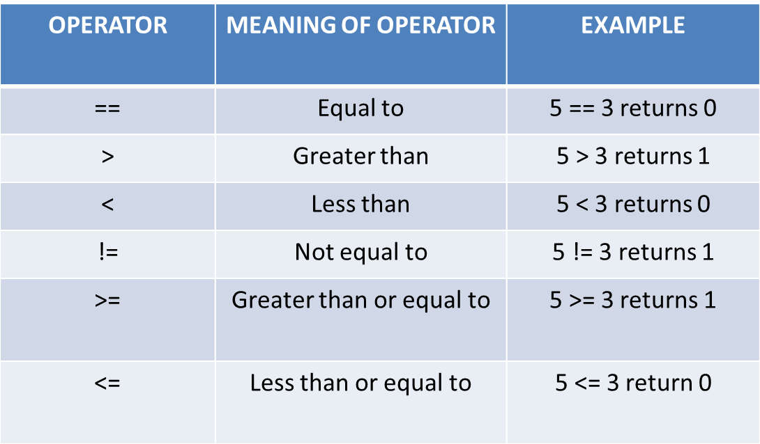
Relational Operators

Slide 20
Logical Operators
An expression containing logical operator returns either 0 or 1 depending upon whether expression results true or false.
It is used to combine the conditions when you have more than one.

Slide 21
Logical Operators
OPERATOR | MEANING OF OPERATOR | EXMPLE
&& | Logical AND. True only if all operands are true. | If c = 5 and d = 2 then, expression ((c = 5) && (d>5)) equals to 0.
|| | Logical OR. True only if either one operand is true. | If c = 5 and d = 2 then, expression ((c = 5) || (d>5)) equals to 1.
! | Logical NOT. True only if the operand is 0. | If c = 5 then expression !(c == 5) equals to 0.

Slide 22
Assignment Operators
Right side value will be assigned to the left side variable
Operator | Example | Meaning
= | a = b | a = b
+= | a += b | a = a+b
-= | a -= b | a = a-b
*= | a *= b | a = a*b
/= | a /= b | a = a/b
%= | a %= b | a = a%b

Slide 23
Increment and Decrement Operators
++ Increment the value by 1.
-- Decrement the value by 1.

Slide 24
What is the difference between ++a and a++?
++a
Pre – increment
First increment by 1 then, it returns the value
Similarly, --a and a--
a++
Post - increment
First return the original value then, it is incremented by 1.

Slide 25
Special Operators
Sizeof()
&
*
Ternary( ? : )

Slide 26
Special Operators
sizeof() operator will returns the number of memory bytes allocated for the data (constant, variables, array, structure etc).

Slide 27
// Program
#include <iostream>
using namespace std;
int main()
{
int a;
float b;
double c;
char d;
cout << sizeof(a));
cout << sizeof(b));
cout << sizeof(c));
cout << sizeof(d));
return 0;
}
1
2
3
4
5
6
7
8
9
10
11
12
13
14
15
16
17
18
19
20
21
22

Slide 28
Special Operators
& is used to get the address of the variable
* is used to get the value of the variable pointed by the pointer

Slide 29
Special Operators
4) Ternary Operator is also known as conditional operator. It works on three operands.
Syntax:
condition ? (statement1) : (statement2);
E.g: 10 < 20 ? printf(" True ") : printf(" False ");

Slide 30


Operators Application

Slide 31
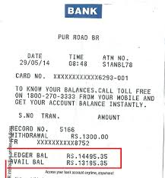
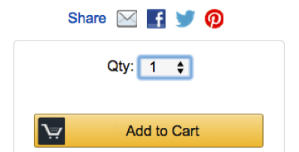
Operators Application

